Slide 1
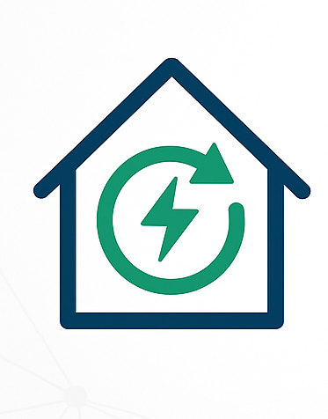
Smart Home Energy Management System (SHEMS)
A Java-based Web Application for Monitoring
& Optimizing Home Energy Usage
By
Deepak Paramesh
Under the guidance
Dr. T.Premalatha

Slide 2
MILESTONE 1

Slide 3
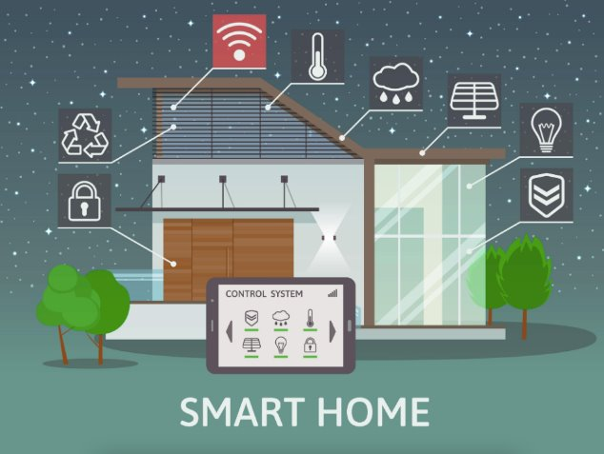
MEANING OF THE TITLE
Smart Home Energy Management System refers to an application that helps homeowners:
Monitor electricity usage of home appliances in real time
Identify high-consuming devices
Predict future consumption patterns
Reduce electricity bills through intelligent recommendations
Manage devices remotely (ON/OFF, scheduling)

Slide 4
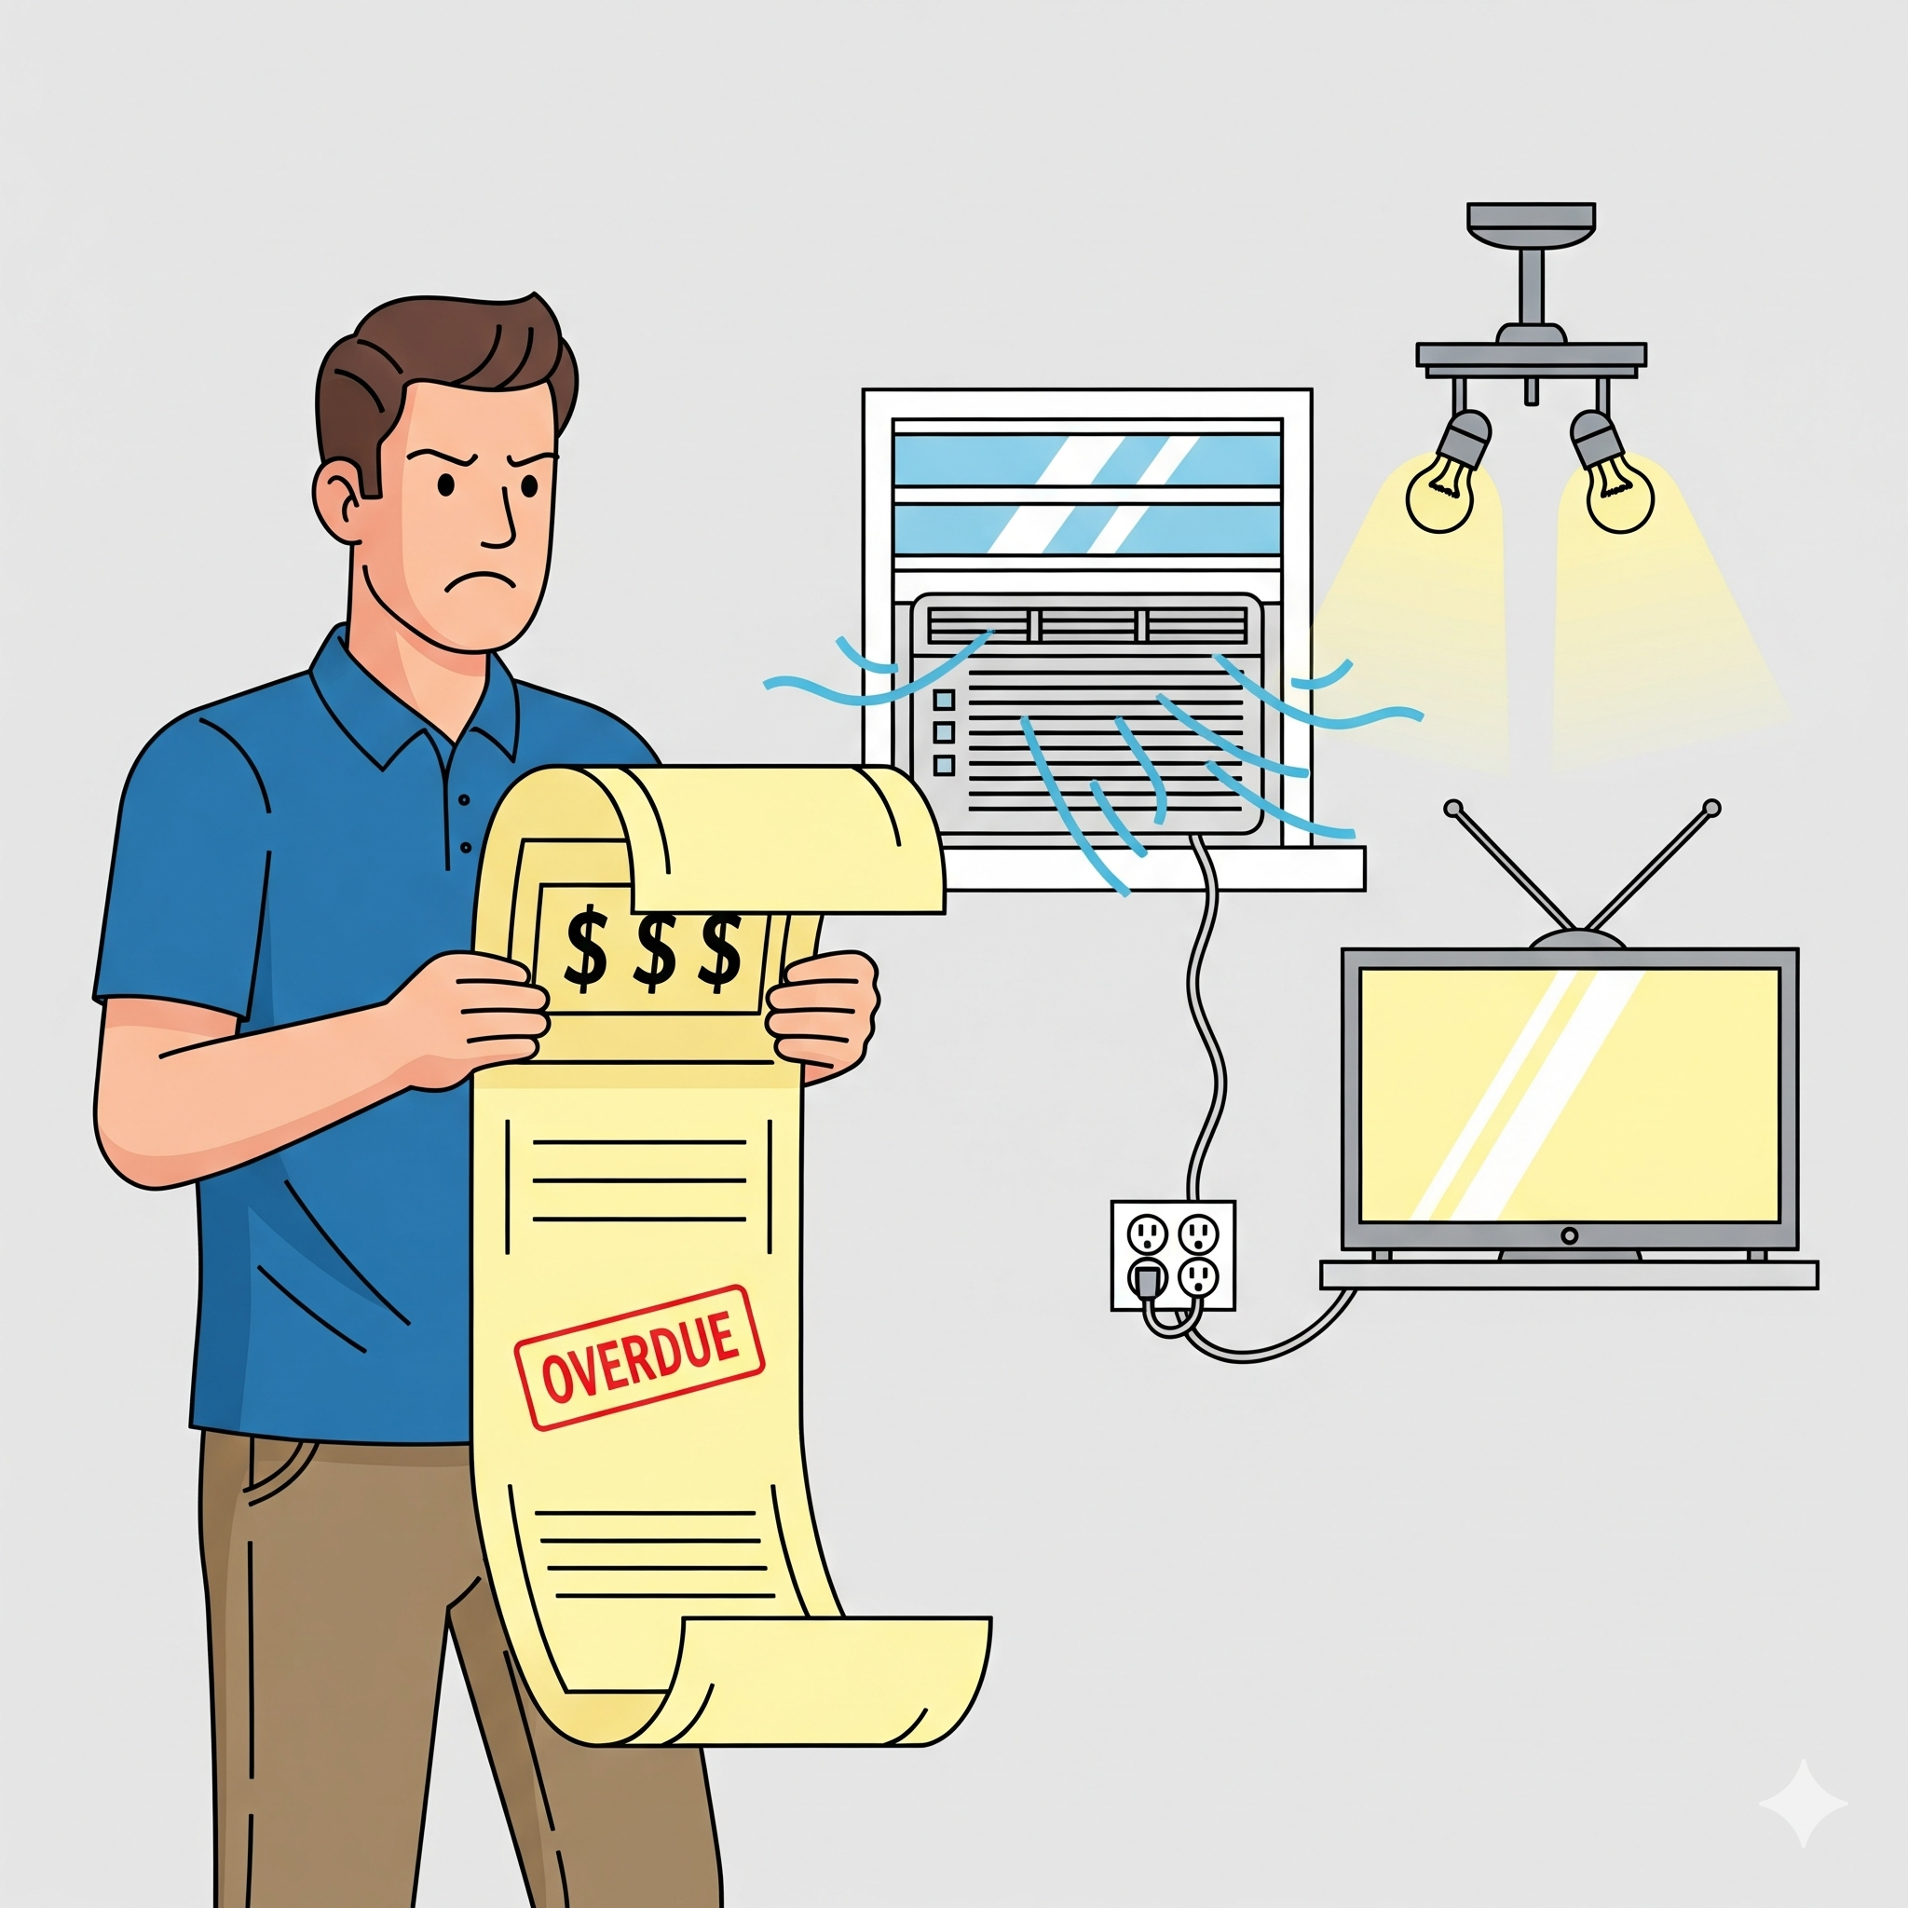
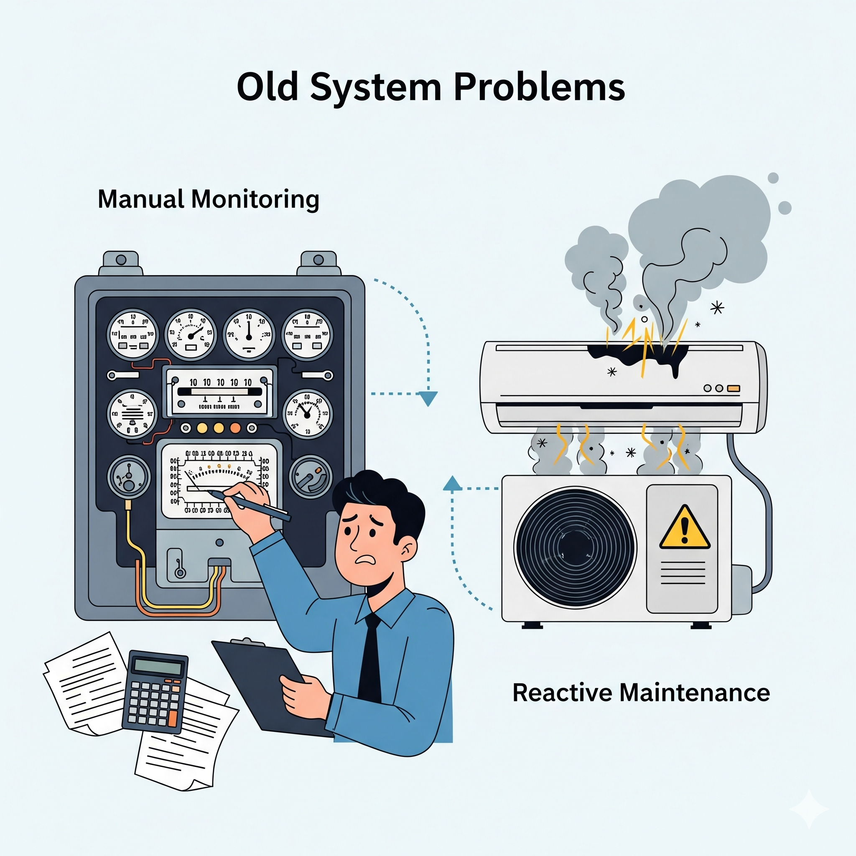
Existing System Limitations
Manual Monitoring: No easy way to track live consumption.
Reactive Maintenance: No alerts for faults or power surges until devices break.
"Bill Shock": High costs without visibility into device-specific data.
Lack of Automation: Appliances rely on manual switching (human error).

Slide 5
PROPOSED SYSTEM
User Authentication & Role Management
Admin, User roles
Secure login, access control
Smart Device Management
Add, update, delete home devices
Store device details (name, power rating, room, category)
Real-Time Energy Tracking
Live energy usage per device
Hourly, daily, weekly reports
Automation & Scheduling
Time-based, condition-based rules
Auto ON/OFF appliances
Alerts & Notifications
High usage, device failure, overheating alerts
Analytics & Reports
Consumption trends, visual charts
Export reports (PDF/CSV)

Slide 6
SYSTEM ARCHITECTURE / CONFIGURATION
1. Presentation Layer (Controller)
Security & Access
Handles UI/API requests
Sends responses
2. Service Layer (Business Logic)
Smart Device Management
Login validation
Device control
Energy calculations
3. Repository Layer (Database Access)
Analytics Dashboard
Performs CRUD operations
Connects to MySQL/PostgreSQL
4. Model Layer (Entities/Data Classes)
Intelligent Automation
User, Device, UsageLog, Schedule
Schedule-based switching.
Threshold-based alerts

Slide 7
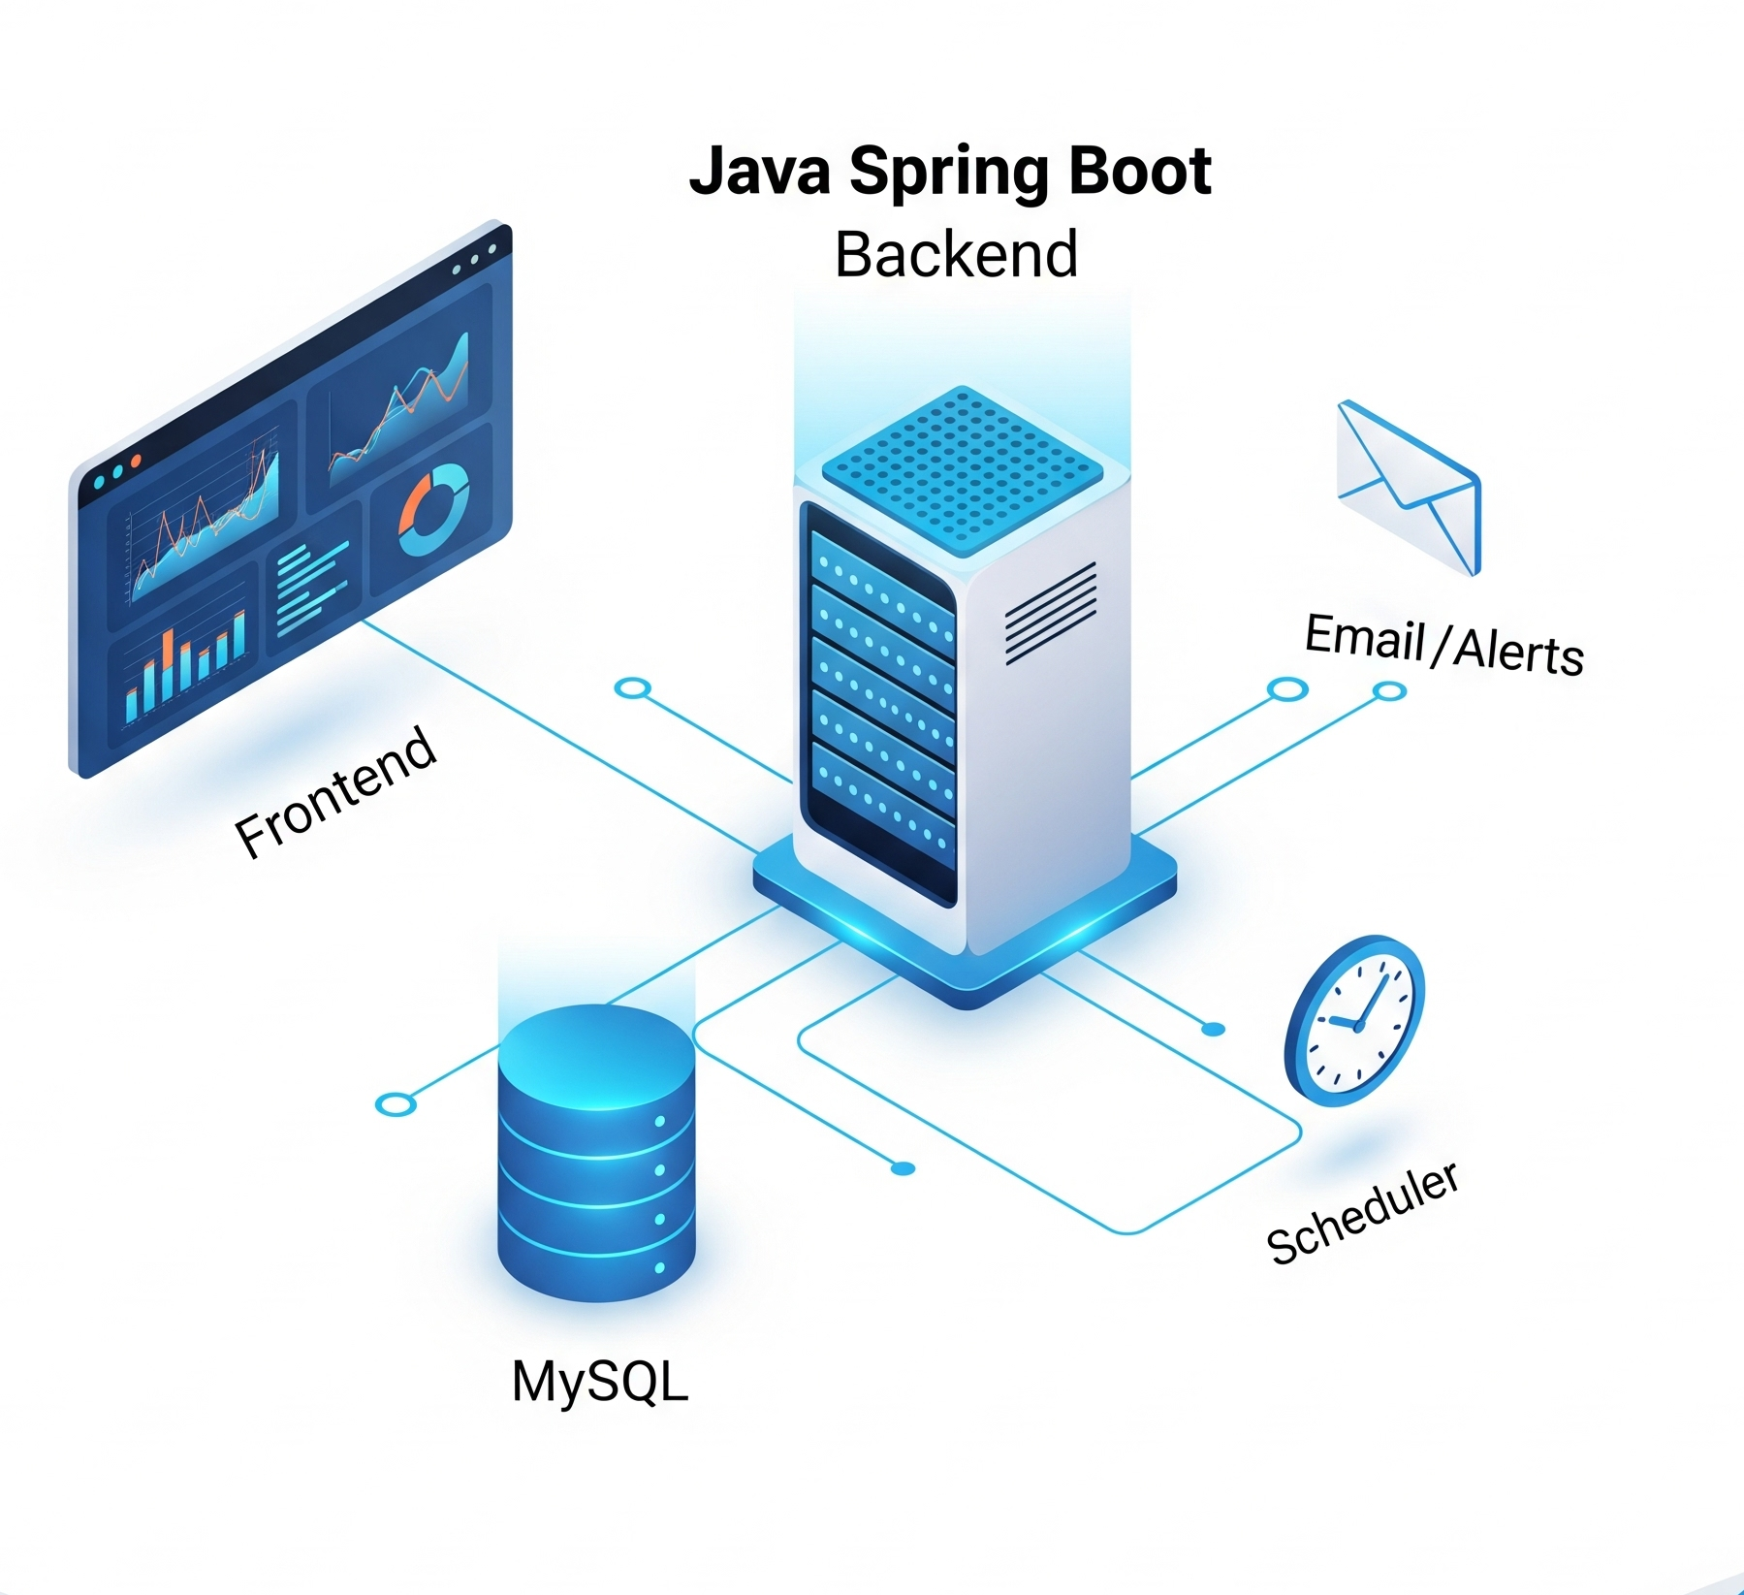
Tech Stack
Frontend: React / Angular / HTML
Used for dashboard, device list, energy charts
Backend: Java Spring Boot
Handles business logic, authentication, device control, tracking
Database: MySQL
Stores users, devices, usage logs, rules, alerts
APIs & Services:
REST API (communication between frontend & backend)
Scheduler Engine (executes automation rules)
Notification Engine (sends alerts via Email/SMS/Pop-ups)

Slide 8
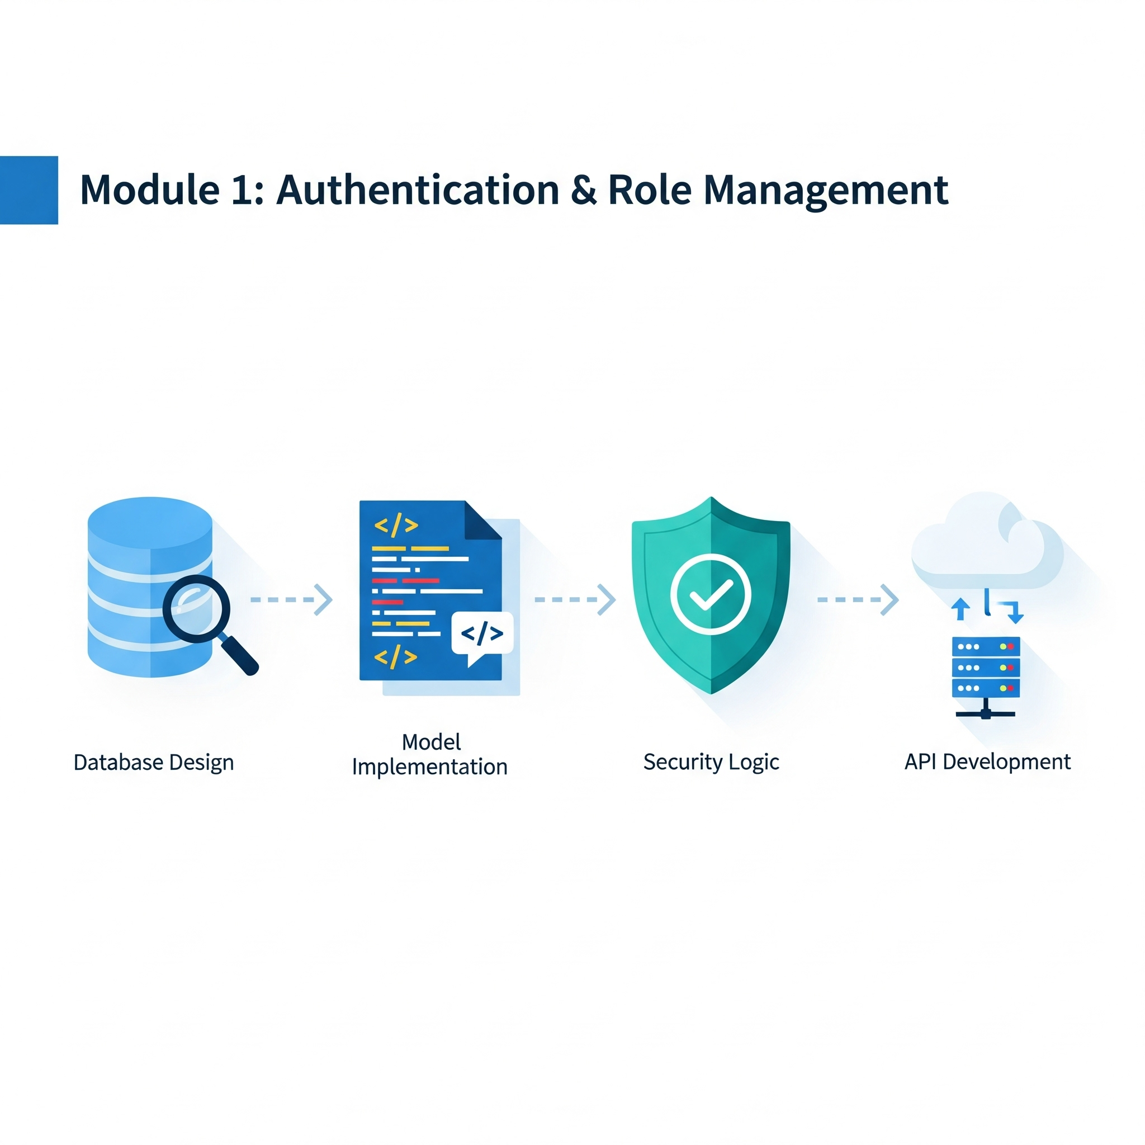
MODULE 1: Authentication & Role Management
Database Design:
Creating the users schema.
Database operations via User Repository
Model Implementation:
Designing User Modelclass
Implementing Auth Controller &Auth Service
Security Logic:
Implementing Password validation and Role assignment.
API Development:
Building the Login/Register endpoints.
Objective: Establish a secure entry point for the application.

Slide 9
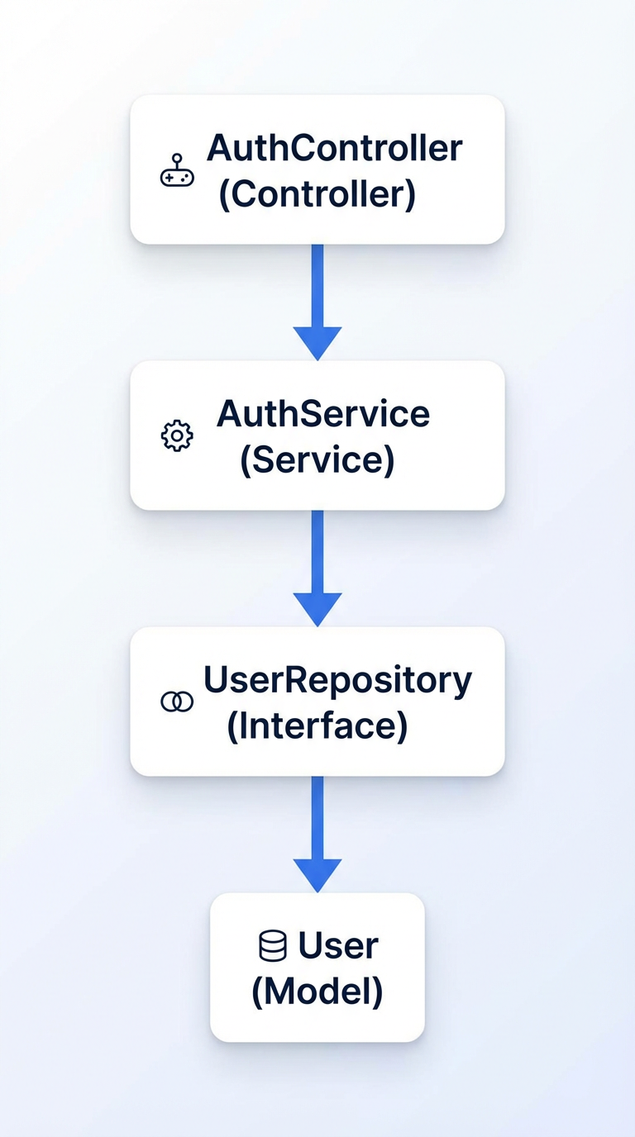
NUMBER OF CLASSES
1. User (Model)
Represents the user entity.
Maps to the users database table.
2. UserRepository (Interface)
Extends JpaRepository.
Handles SQL queries like findByUsername().
3. AuthService (Service)
Contains logic for login validation and token generation.
4. AuthController (Controller)
Exposes REST endpoints: /login, /register.

Slide 10
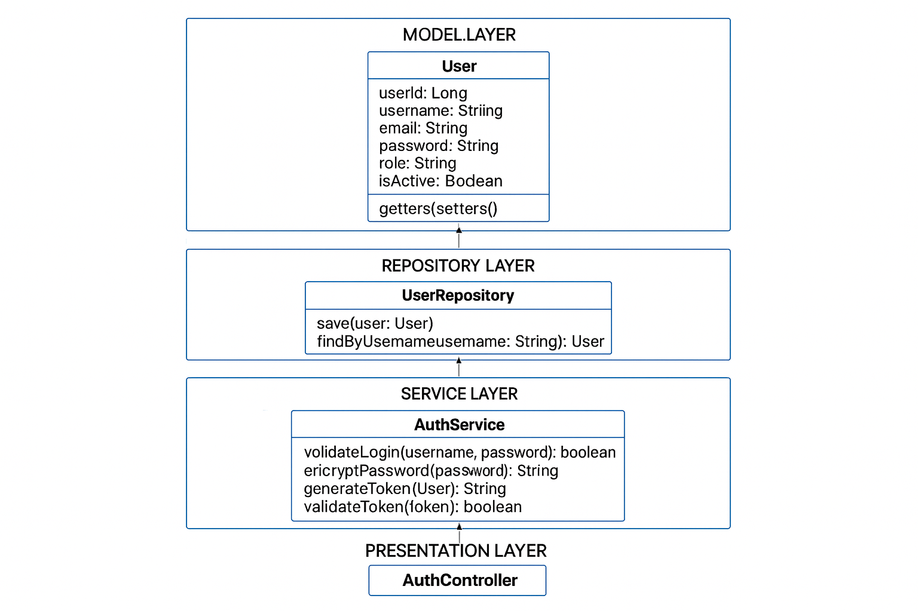
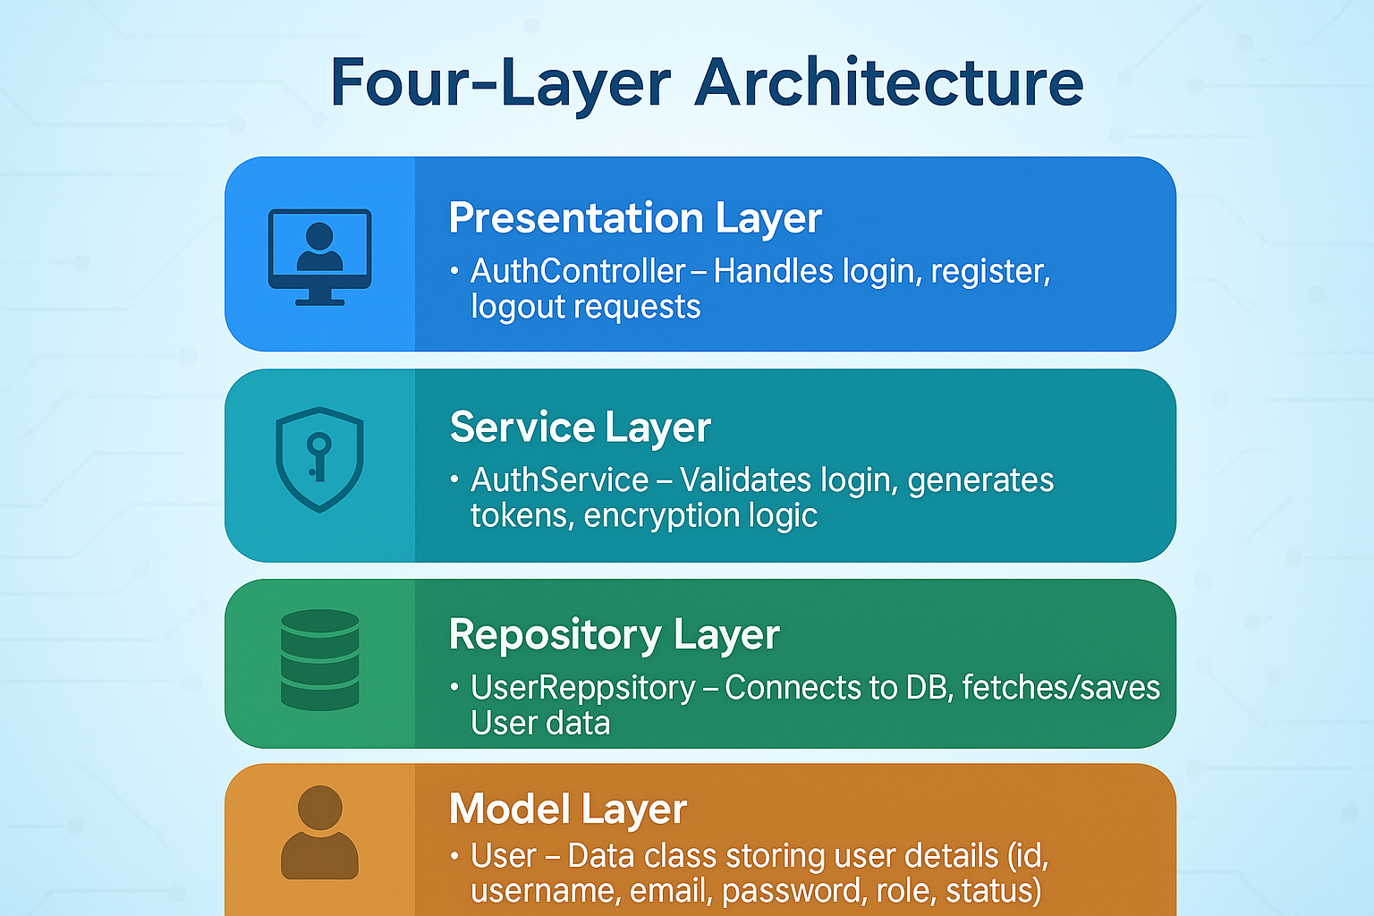
CLASS DIAGRAMS

Slide 11
DATABASE SCHEMA FOR MODULE 1
Field Name | Data Type | Constraints
user_id | BIGINT | Auto increment ID
username | VARCHAR(50) | Unique, Not Null
email | VARCHAR(100) | Unique
password | VARCHAR(255) | Encrypted password
role | VARCHAR(30) | ADMIN / USER / MANAGER
is_active | BOOLEAN | Account status

Slide 12
MILESTONE 2 (Pseudo Code)

Slide 13
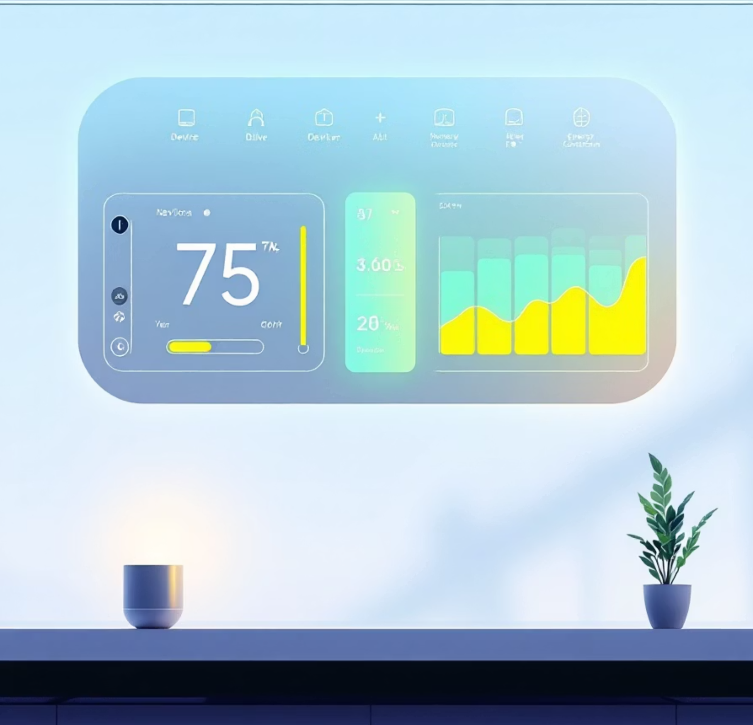
Smart Home Energy Management System A comprehensive modular architecture for secure access, device management, real-time energy tracking, analytics, and automation.

Slide 14
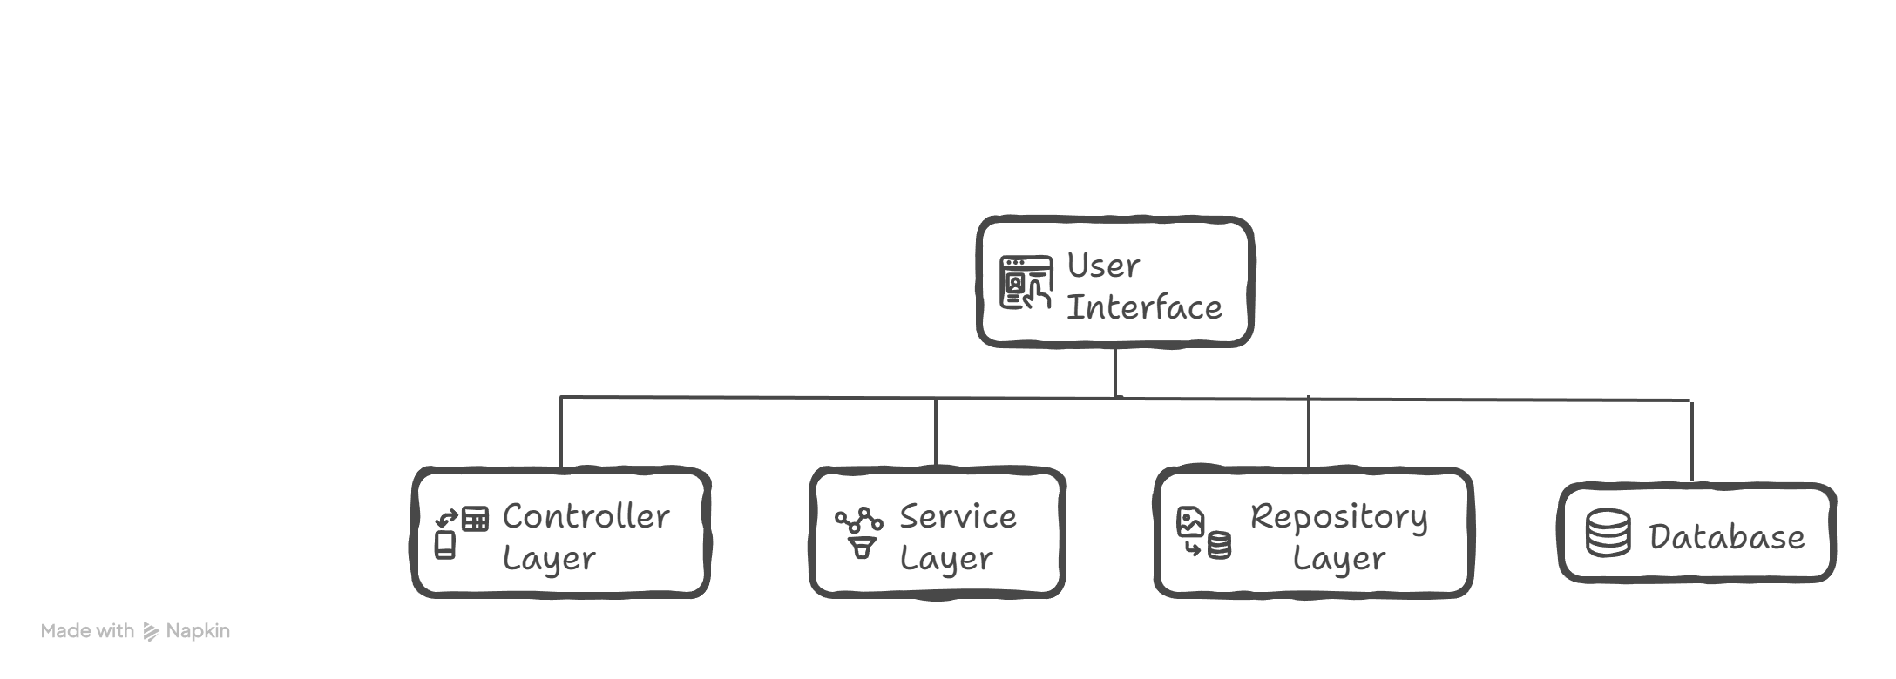
SYSTEM ARCHITECTURE
MODULE OVERVIEW
Modules | Name | Responsibility
Module1 | Authentication | User login & security
Module2 | Smart Device Management | Device control
Module3 | Real-Time Energy Tracking | Energy data
Module4 | Analytics Dashboard | Usage insights
Module5 | Scheduling & Automation | Auto control

Slide 15
MODULE 1
Authentication Module
Purpose
Provides secure access to the Smart Home Energy Management System.
Classes & Responsibilities
User (Data Class)
AuthController
Properties
Functions
userId
signup(userDetails)
name
signin(loginDetails)
email
forgotPassword(email)
username
✔ Receives user input
✔ Forwards requests to AuthService
password
role
✔ Stores user information
✔ No business logic
AuthService
UserRepository
Functions
Functions
signup() → checks existing user, saves data
saveUser(user)
signin() → validates credentials, generates token
findUser(username)
forgotPassword() → sends reset link
✔ Handles database operations only
✔ Contains authentication logic
✔ Ensures system security

Slide 16
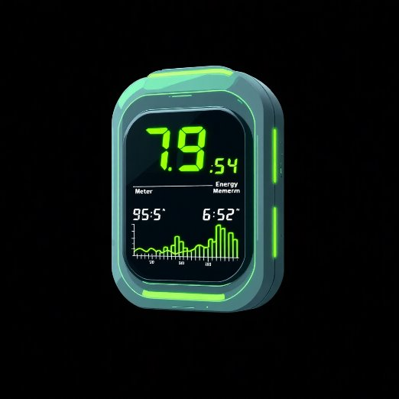
MODULE 2
Smart Device Management
Purpose
Manages smart devices and controls their ON/OFF state.
Classes & Responsibilities
SmartDevice (Data Class)
Properties
DeviceService
deviceId
Functions
deviceName
deviceType
addDevice()
powerUsage
turnOn()
status
turnOff()
✔ Stores device information
✔ Executes device control logic
DeviceController
DeviceRepository
Functions
Functions
addDevice(device)
save(device)
turnOnDevice(deviceId)
find(deviceId)
turnOffDevice(deviceId)
✔ Stores and retrieves device data
✔ Receives device commands from user

Slide 17
MODULE 3
Real-Time Energy Tracking
Purpose
Tracks and stores real-time energy consumption of devices.
Classes & Responsibilities
EnergyUsage (Data Class)
EnergyController
Properties
Functions
deviceId
recordEnergy(data)
energyUsed
viewEnergy(deviceId)
time
✔ Receives energy tracking requests
✔ Stores energy consumption data
EnergyService
EnergyRepository
Functions
Functions
saveEnergy(data)
save(data)
getEnergy(deviceId)
find(deviceId)
✔ Handles energy calculation and retrieval
✔ Stores energy usage records

Slide 18
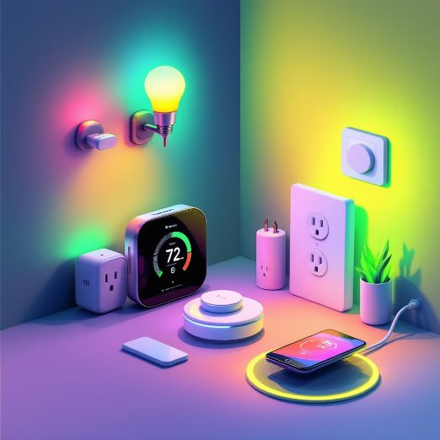
MODULE 4 4
1
Analytics Dashboard
Purpose
Provides insights and summaries of energy consumption.
Classes & Responsibilities
AnalyticsController
Functions
showDashboard()
✔ Requests analytics data
AnalyticsService
Functions
getSummary()
Calculates total energy usage
Calculates daily consumption
Displays analytical results
✔ Converts raw data into meaningful insights

Slide 19
MODULE 5
Scheduling & Automation
Purpose
Automates device operations based on time and rules.
Classes & Responsibilities
AutomationRule (Data Class)
AutomationService
Properties
Functions
deviceId
addRule(rule)
time
schedule action
action
✔ Manages automation logic
✔ Stores automation rules
SchedulerService
AutomationController
Functions
Functions
runRule(rule)
addRule(rule)
Executes action at scheduled time
✔ Receives automation rule input
✔ Performs automated operations

